Slide 1

BIG DATA ANALYSIS
ON
H1B VISA APPLICANTS
Presented By
Mr. Tirunagari Raghavendra
S171108400422

Slide 2

IT CONTAINS
Big Data
Hadoop
HDFS
MapReduce
Hive
Pig
Sqoop
Analyzing of H1b Visa
Use Cases

Slide 3
BIG DATA
Big Data is the term that describes the large volume of data i.e, if the
data which is beyond to the storage capacity and which is beyond to the
process power is known as Big Data.
In 1990 In 2017
1GB-20GB HD
64-128MB RAM
DT10Kbps DT100Mbps
Here the data of three types. They are
-- Structured data : Relational data.
-- Semi Structured data : XML data.
-- Unstructured data : Word, PDF, Text, Media Logs.
What comes under Big Data?
-- Black Box Data.
-- Social Media Data.
-- Stock Exchange Data.
-- Power Grid Data.
-- Transport Data.
-- Search Engine Data.
-- Online Shopping Data
-- Hospitality Data.
500GB-1TB HD
4-16GB RAM

Slide 4
To get a better understanding of what Big Data is, it is often described using 5 Vs:
Variety
Veracity
Value

Slide 5
To rectify the issues of Big Data there are challenges given below:
-- Capturing data
-- Curation
-- Storage
-- Searching
-- Sharing
-- Transfer
-- Analysis
-- Presentation

Slide 6
HADOOP
Hadoop is an open source framework developed by Apache Software
Foundation.
Hadoop can easily perform parallel programming model.
Hadoop framework can store large amount of data and variety of the
data with very high speed.
Hadoop framework will store the data in terms of files. The file system
format which is followed by the hadoop framework is HDFS (Hadoop
Distributed File System)
To process the data which is present inside hadoop framework we use
MapReduce programming models.
To implement the Business Logics by using MapReduce, time convert
and development cost also increases.
To overcome the above problem, we can use hadoop eco system which
lies on the top of the hadoop.

Slide 7
Hadoop’s History:
-- Hadoop was created by Doug Cutting & Michael J. Cafarella.
-- Doug Cutting, who was working at Yahoo at that time, named it
after his son’s toy elephant.
-- It was originally developed to support distribution for the Nutch
Search Engine Project.
-- Hadoop is based on work done by Google in the late 1990’s and
early 2000’s.
-- Specially, on papers describing the Google File System (GFS)
published in 2003 and MapReduce is published in 2004.

Slide 8
How Does Hadoop Work?
-- Hadoop runs code across a cluster of computers. This process
includes the following core tasks that Hadoop performs:
. Data is initially divided into directories and files. Files are
divided into uniform sized blocks of 128MB and 64MB
(preferably 128MB).
. These files are then distributed across various cluster nodes for
further processing.
. HDFS, being on top of the local file system, supervises the
processing.
. Blocks are replicated for handling hardware failure.
. Checking that the code was executed successfully.
. Performing the sort that takes place between the map and
reduce stages.
. Sending the sorted data to a certain computer.
. Writing the debugging logs for each job.

Slide 9
Advantages of Hadoop:
Hadoop framework allows the user to quickly write and test distributed
systems.
It is efficient, and it automatic distributes the data and work across the
machines and in turn, utilizes the underlying parallelism of the CPU
cores.
Hadoop does not rely on hardware to provide fault-tolerance and high
availability (FTHA), rather Hadoop library itself has been designed to
detect and handle failures at the application layer.
Servers can be added or removed from the cluster dynamically and
Hadoop continues to operate without interruption.
Another big advantage of Hadoop is that apart from being open source,
it is compatible on all the platforms since it is Java based.

Slide 10
Features of Hadoop:
Horizontally Scaling
Nodes
High qualibility of data even in node failure
Communication and Synchronization
Less network bandwidth
Hadoop framework provides the alternatives to the nodes failures
Commodity Hardware
Daemons of hadoop

Slide 11
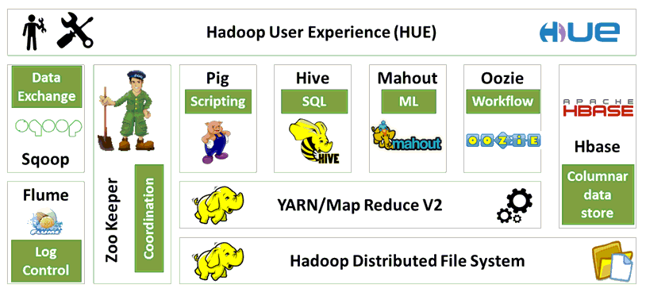
Hadoop Architecture

Slide 12
HDFS
DFS:
DFS stands for Distributed File System.
System that permanently store data is said to be distributed file system.
DFS support concurrency, distribution, replication access to file and
remote servers.
The data is divided into logical units (files, shards, chunks, blocks).
DFS’s are working network based approach because of DFS’s are more
complex than regular disks file systems.
Example: File system tolerates node failure without suffering data loss.

Slide 13
HDFS:
Hadoop is a distributed file system and it uses to store large amount
of data like terabytes, petabytes, zetabytes etc.
HDFS supports high throughput mechanism for accessing this large
amount of information.
In HDFS files are stored in sequential redundant manner over the
multiple machines and this guaranteed the following ones.
1. Durability to failure
2. High availability to very parallel applications

Slide 14
Advantages of HDFS:
HDFS store large amount of information.
HDFS is simple and robust coherency model.
HDFS is reliable for long period of time.
HDFS is scalable and fast access to this information and it also possible
to serve large number of clients by simply adding more machines to the
cluster.
HDFS should integrate well with Hadoop MapReduce allowing data to
be read and computed upon locally when possible.
HDFS providing streaming read performance.
Data will be written to the HDFS – once and then read several times.
The overhead of cashing is helps the data should simply be re-read from
HDFS source.
Fault-tolerance by detecting faults and applying quick, automatic
recovery.
Processing logic close to the data, rather than data close to the processing
logic.

Slide 15
Features of HDFS:
HDFS is file system designed for storing have some key characteristics.
They are
1. Support for very large files.
2. Commodity Hardware.
3. Streaming data access.
4. High-latency data access.
5. Lots of small files.
6. Multiple writers, arbitrary file modifications.
7. Moving computation is then moving data.

Slide 16


Slide 17
MapReduce
Introduction of MapReduce:
MapReduce published in 2004 by Google.
Hadoop can run MapReduce programs written in various programming
languages like java, ruby, python and c++.
MapReduce is a parallel programming model for processing the huge
amount of data.
MapReduce making the structure data and out of some unstructured
data….
MapReduce provides automatic parallelization & distributions, fault-
tolerance, I/O scheduling, monitoring, starters and updates.

Slide 18
What is MapReduce?
To take the advantage of parallel processing of Hadoop, the query
must be in MapReduce form.
The MapReduce is a paradigm which has two phases, the mapper
phase and the reducer phase.
In the Mapper the input is given in the form of key value pair. The
output of the mapper is fed to the reducer as input.
The reducer runs only after the mapper is over. The reducer too
takes input in key value format and the output of reducer is final
output.

Slide 19
MapReduce History:
In 2004, MapReduce Paper released.
In 2006, Lucen’s sub-project released.
In 2008, Apache top-level project fastest sort of data.
In 2012, MapReduce 2.0 (YARN) released. YARN stands for Yet
Another Resource Negotiator.

Slide 20
Steps in Map Reduce:
Map takes a data in the form of pairs and returns a list of <key,
value> pairs. The keys will not be unique in this case.
Using the output of Map, sort and shuffle are applied by the
Hadoop architecture. This sort and shuffle acts on these list of
<key, value> pairs and sends out unique keys and a list of values
associated with this unique key <key, list(values)>.
Output of sort and shuffle will be sent to reducer phase. Reducer
will perform a defined function on list of values for unique keys
and Final output will<key, value> will be stored/displayed.

Slide 21
How MapReduce works:
Let’s understand this with an example –
Consider you have following input data for your MapReduce Program
Welcome to Hadoop Class
Hadoop is good
Hadoop is bad

Slide 22
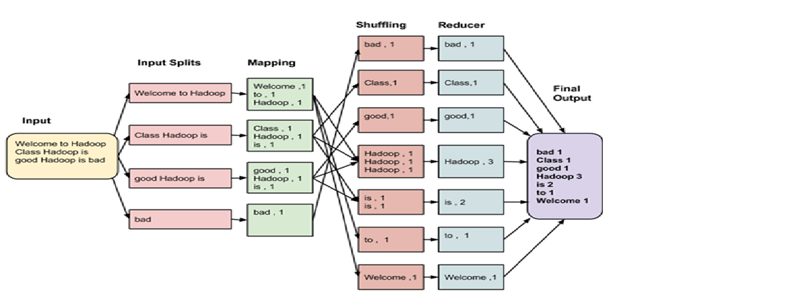

Slide 23
Hive
What is Hive?
Hive is a data warehouse infrastructure tool to process structured
data in Hadoop.
It resides on top of Hadoop to summarize Big Data, and makes
querying and analyzing easy.
Initially Hive was developed by Facebook, later the Apache
Software Foundation took it up and developed it further as an open
source under the name Apache Hive.
It is used by different companies. For example, Amazon uses it in
Amazon Elastic MapReduce.

Slide 24
Hive is not:
A relational database
A design for Online Transaction Processing (OLTP)
A language for real-time queries and row-level updates
Features of Hive:
It stores schema in a database and processed data into HDFS.
It is designed for OLAP.
It provides SQL type language for querying called HiveQL or HQL.
It is familiar, fast, scalable, and extensible.

Slide 25
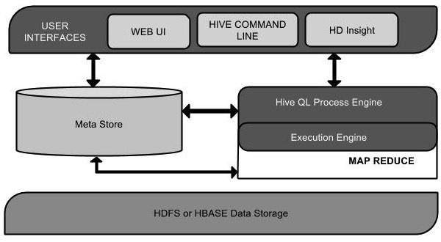
Architecture of Hive:
The following component diagram depicts the architecture of Hive:

Slide 26
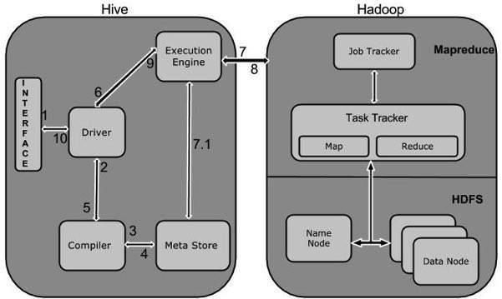
Working of Hive:
The following diagram depicts the workflow between Hive and Hadoop.

Slide 27
Pig
What is Apache Pig?
Apache Pig is an abstraction over MapReduce. It is a tool/platform
which is used to analyze larger sets of data representing them as data
flows. Pig is generally used with Hadoop; we can perform all the data
manipulation operations in Hadoop using Apache Pig.
To write data analysis programs, Pig provides a high-level language
known as Pig Latin. This language provides various operators using
which programmers can develop their own functions for reading,
writing, and processing data.
To analyze data using Apache Pig, programmers need to write scripts
using Pig Latin language. All these scripts are internally converted to
Map and Reduce tasks. Apache Pig has a component known as Pig
Engine that accepts the Pig Latin scripts as input and converts those
scripts into MapReduce jobs.

Slide 28
Why Do We Need Apache Pig?
Programmers who are not so good at Java normally used to struggle
working with Hadoop, especially while performing any MapReduce
tasks. Apache Pig is a boon for all such programmers.
Using Pig Latin, programmers can perform MapReduce tasks easily
without having to type complex codes in Java.
Apache Pig uses multi-query approach, thereby reducing the length
of codes. For example, an operation that would require you to type
200 lines of code (LoC) in Java can be easily done by typing as less
as just 10 LoC in Apache Pig. Ultimately Apache Pig reduces the
development time by almost 16 times.
Pig Latin is SQL-like language and it is easy to learn Apache Pig
when you are familiar with SQL.
Apache Pig provides many built-in operators to support data
operations like joins, filters, ordering, etc. In addition, it also
provides nested data types like tuples, bags, and maps that are
missing from MapReduce.

Slide 29
Features of Pig:
Apache Pig comes with the following features −
-- Rich set of operators
-- Ease of programming
-- Optimization opportunities
-- Extensibility
-- UDF’s
-- Handles all kinds of data

Slide 30
Applications of Apache Pig:
Apache Pig is generally used by data scientists for performing tasks
involving ad-hoc processing and quick prototyping. Apache Pig is
used −
-- To process huge data sources such as web logs.
-- To perform data processing for search platforms.
-- To process time sensitive data loads.

Slide 31
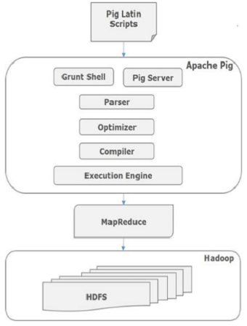
Architecture of Apache Pig:
The architecture of Apache Pig is shown below.

Slide 32
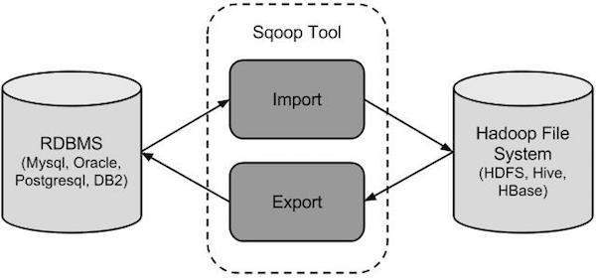
Sqoop
Sqoop:
Sqoop is a tool designed to transfer data between Hadoop and
relational database servers. It is used to import data from
relational databases such as MySQL, Oracle to Hadoop HDFS,
and export from Hadoop file system to relational databases.
Sqoop: “SQL to Hadoop and Hadoop to SQL”
How Sqoop Works?
The following image describes the workflow of Sqoop.

Slide 33
Sqoop Import:
The import tool imports individual tables from RDBMS to HDFS.
Each row in a table is treated as a record in HDFS. All records are
stored as text data in text files or as binary data in Avro and
Sequence files.
Sqoop Export:
The export tool exports a set of files from HDFS back to an RDBMS.
The files given as input to Sqoop contain records, which are called as
rows in table. Those are read and parsed into a set of records and
delimited with user-specified delimiter.
As Sqoop is a sub-project of Hadoop, it can only work on Linux
operating system.

Slide 34
Analyzing of H1b Visa
Analyzing of H1b Visa:
The H1B is an employment-based, non-immigrant visa category for temporary foreign workers in the United States. For a foreign national to apply for H1B visa, an US employer must offer a job and petition for H1B visa with the US immigration department. This is the most common visa status applied for and held by international students once they complete college/ higher education (Masters, Ph.D.) and work in a full-time position.

Slide 35
USE CASES IN MAPREDUCE:
3) Which industry has the most number of Data Scientist positions?
4) Which top 5 employers file the most petitions each year?
5) Find the most popular top 10 job positions for H1B visa applications
for each year?
10) Which are the top 10 job positions which have the highest success
rate in petitions?
USE CASES IN PIG:
1 a) Is the number of petitions with Data Engineer job title increasing
over time?
1 b) Find top 5 job titles who are having highest growth in applications?
Which industry has the most number of Data Scientist positions?
6) Find the percentage and the count of each case status on total applications for each year. Create a graph depicting the pattern of All the cases over the period of time.

Slide 36
7) Create a bar graph to depict the number of applications for each year
9) Which are top ten employers who have the highest success rate in petitions?
USE CASES IN HIVE:
2 a) Which part of the US has the most Data Engineer jobs for each year?
2 b) find top 5 locations in the US who have got certified visa for each year?
4) Which top 5 employers file the most petitions each year?
7) Create a bar graph to depict the number of applications for each year.
8) Find the average Prevailing Wage for each Job for each Year (take part time
and full time separate)
USE CASES IN SQOOP:
11) Export result for question no 10 to MySql database.

Slide 37
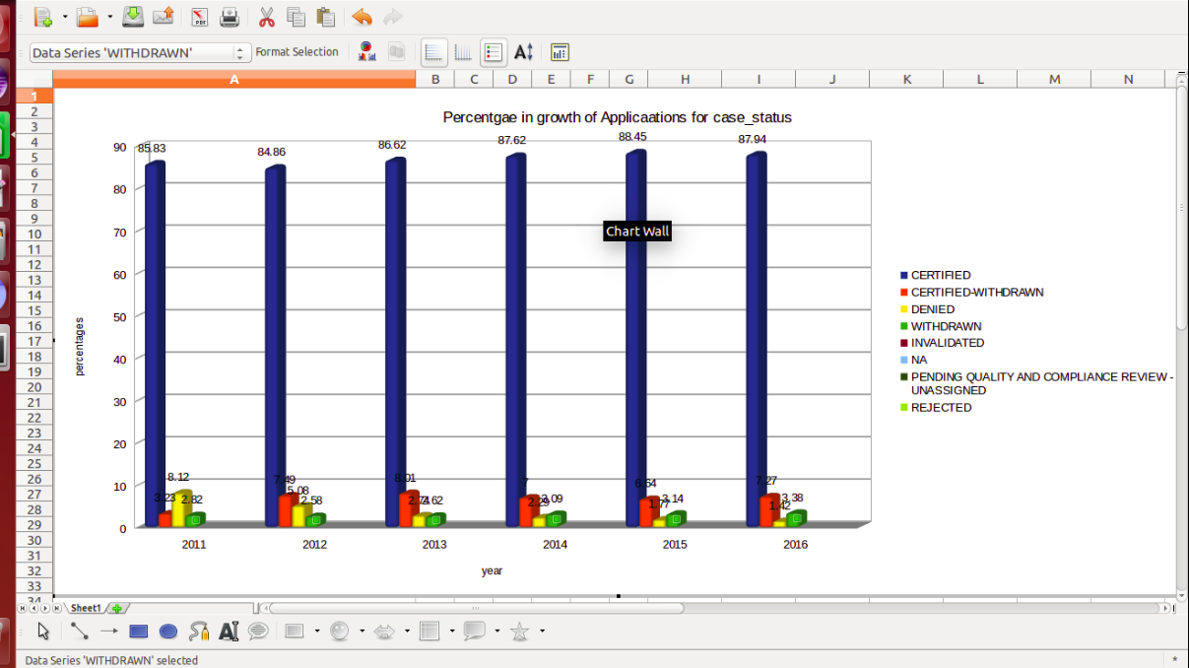

Slide 38
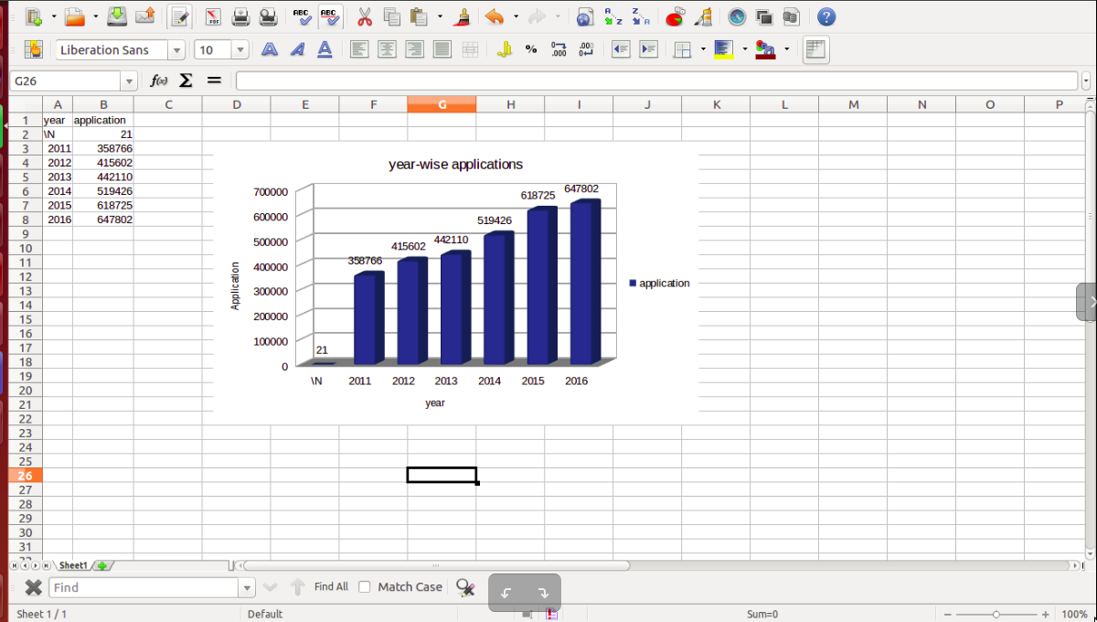

Slide 39


Slide 40


